Slide 1
ENGR 12
Dr. Mandala
Notes:
Down

Slide 2
Modifiers
float numvar = 3.145; int numv = 3; char name[]=“Jonathan”
Modifier | display
%3d | 3
%3.2d | 0 3
%0.2d | 0 3
%3f | 3 . 1 4 5 0 0 0
%3.2f | 3 . 1 4
%0.2f | 3 . 1 4
%10s | J o n a t h a n
%0.4s | J o n a
_ represents a single character width (when blank = space)

Slide 3
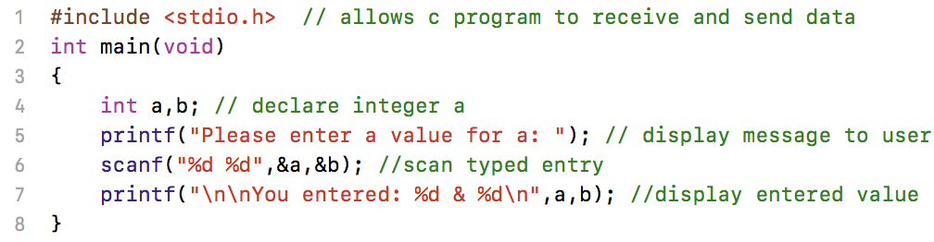
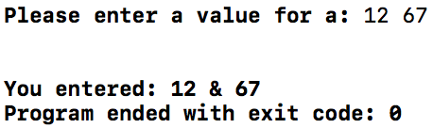
Reading data into C
Use scanf command (prototyped in header file stdio.h)
SYNTAX
scanf(“format string”,&variable_list)
scanf does not print any value to screen!! Use printf to display a message to let user know that they need to type data.

Slide 4
Windows ONLY Error
Windows users might encounter issues with using scanf in Visual Studio; there is nothing wrong with the command, the issue is rather a Microsoft issue
The following steps show you how to fix the problem:
After opening a project, click on PROJECT in the toolbar, then on Properties option at the bottom of the list
Select (left panel) Configuration Properties > C/C++ > Preprocessor
Select (right panel) Preprocessor Definition and click on the arrow that appears
Select Edit and enter: _CRT_SECURE_NO_WARNINGS
Click OK
You can also place the following line at the very top (before preprocessor macros) of your code: #define _CRT_SECURE_NO_WARNINGS

Slide 5
scanf utility
scanf is basic but powerful. It scans for text entry and picks the bits you want (specified by conversion characters)
Use | KEYBOARD STREAM | Values selected
scanf(”%d %f”,&a,&b) | 12 _ ⏎45.313 | a=12 b=45.313
scanf(“mahi%d”,&a) | mahi12 _ 34.3 | a=12
scanf(“%d”,&a); scanf(”%c”,&n); | 12 _ A | a=12 n=’_’
scanf(“%d”,&a); fflush(stdin); scanf(”%c”,&n); | 12 _ A | a=12 n=’A’

Slide 6
Arrays
When initializing:
type variable_name [size 1st dim][size 2nd dim][…]
int grades[10]; // will create 10 element array of integers
int oddsratio[2][2]; //will create a 2x2 array of integers
When accessing:
variable_name[index 1st dim][index 2nd dim][…]
a=grades[0]; //will access first element in grades
risk=oddsratio[1][1]; //will access 2 row 2 col element

Slide 7
Example
int x[3]={1,2,3};//1x3 array
double y[2];//1x2 array
y[0] = 1.5;
y[1] = 4.0;
/* 2x3 arrays; note that the nested braces, which indicate the intended row in y, are optional */
int y[2][3]={
{1,2,0},
{4,5,6}
};
/* x is equivalent to y */
int x[2][3]={1,2,0,4,5,6};

Slide 8
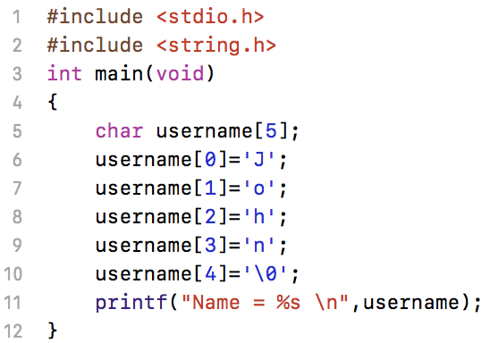
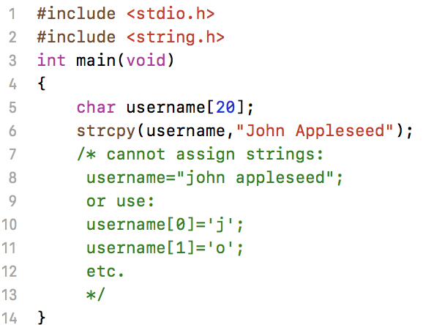


String Arrays
In C, strings are stored as character arrays
end of string character: \0
helps C identify end of string
strcpy automatically adds end of string \0
requires header file: string.h

Slide 9
Printing strings
Use printf with conversion characters: %s
Use %c for character
Use putchar for single character variables
putchar(variable_name);
Use puts for string variables
puts(variable_name);

Slide 10
Note: Arrays
You can initialize and assign values for arrays without declaring size.
int grades[]={1,2,3,4,5}; //initializes grades[5]
char name[]=“Jonathan Smith”; //initializes name[14]
Works only for one dimensional arrays

Slide 11
Struct User Defined Data type
struct forms the final member of data types available in C
struct, int, float, char are the only data types in C.
struct is user defined and can contain the other three data types.
struct variable_name {
type property_name; //int grades
type property_name; //char name[20]
…
};
If defined outside main(): Global scope
All functions within script can access
If defined inside main(): Local scope
Only functions within main script access

Slide 12
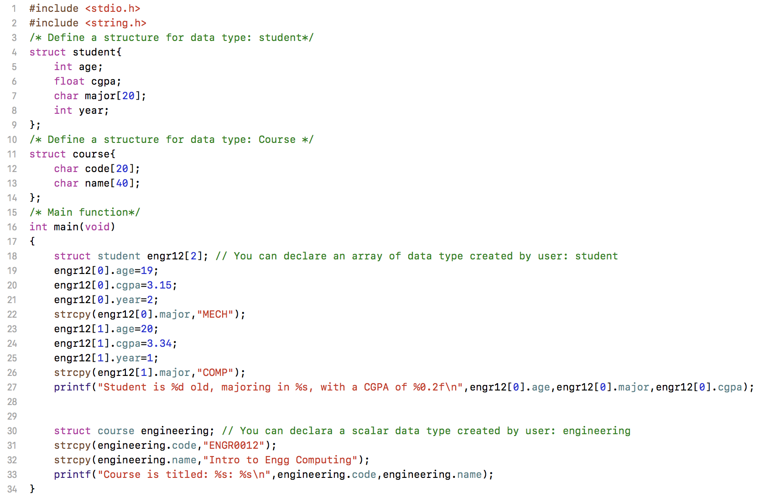

STRUCT Sample code

Slide 13
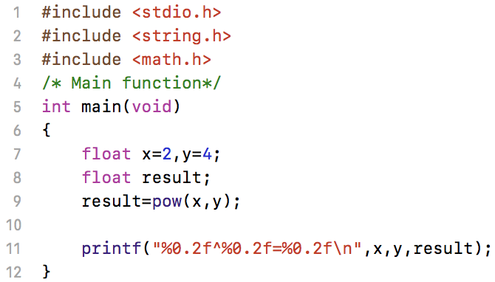

Arithmetic Operations
Standard C allows the use of following operators:
+ for addition
- for subtraction
* for multiplication
/ for division
% for remainder (same as rem command in MATLAB)
There is no power operator (^ or **) in C for exponentiation.
Include header file: math.h
Use pow(base,power)

Slide 14
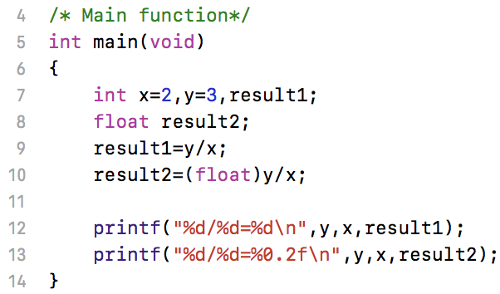

Data types in C arithmetic
Type | Operator | Type | Result Type
int | + - / * % | int | int
float | + - / * % | int | float
int | + - / * % | float | float
float | + - / * % | float | float
pow() results in float/double, and requires float/double input
To force a specific type, use the cast operator as shown below:

Slide 15
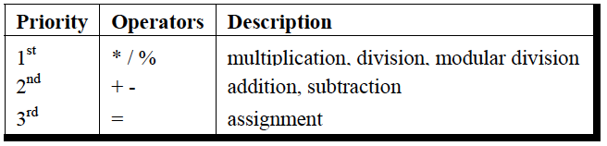
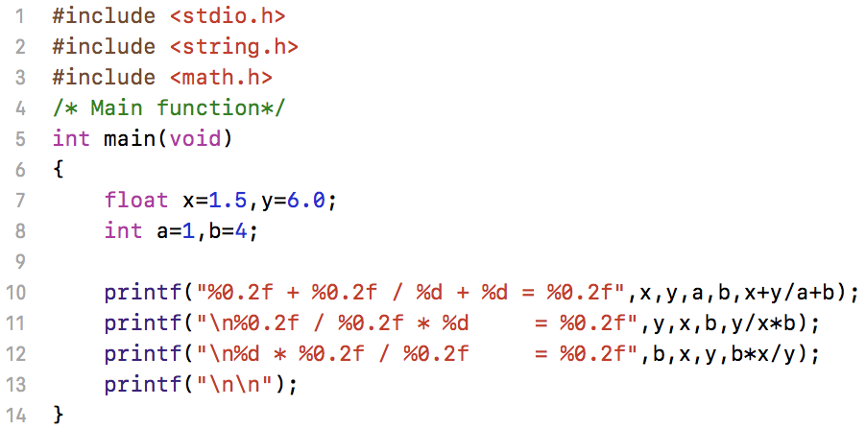
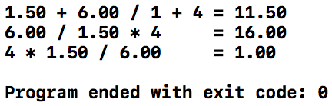
Hierarchy of operations

Slide 16
Relational Operators
Relational operators compare two operands to produce a Boolean result.
In C any non-zero value (1 by convention) is considered to be true and 0 is considered to be false.
Operator | Meaning
> | greater than
>= | greater than or equal
< | less than
<= | less than or equal
== | equal to NOTE: float variables may not result in equal values due to precision of each
!= | not equal to

Slide 17
Logical Operators
Operator | Meaning
&& | AND
|| | OR
! | NOT

Slide 18
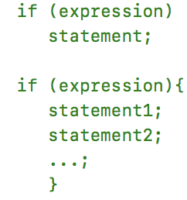
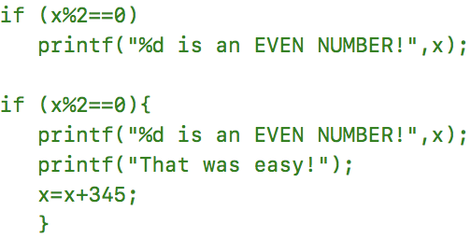
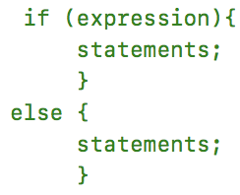
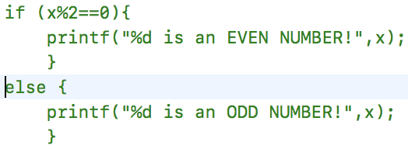
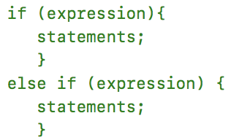
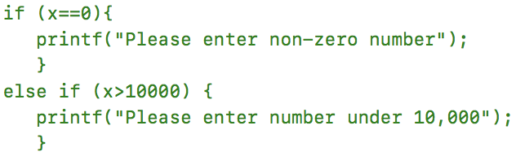
If statement

Slide 19
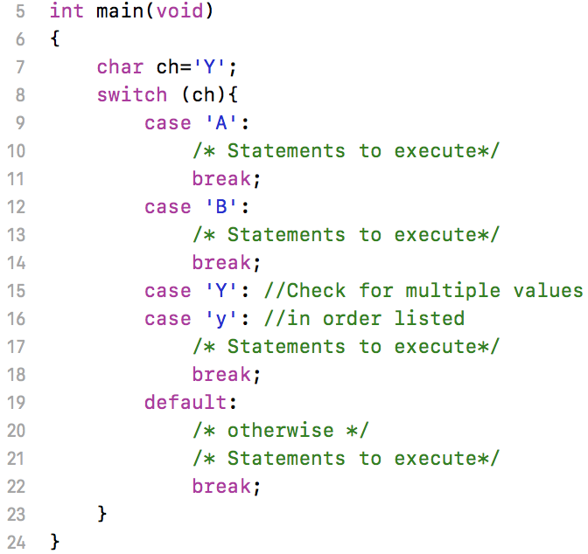
Switch Statement
int or char as input
note format
Each case must end with break
C will continue executing statements after case match until break is encountered or switch ends
Compares variables to each case in order, when matched, starts executing inner code

Slide 20
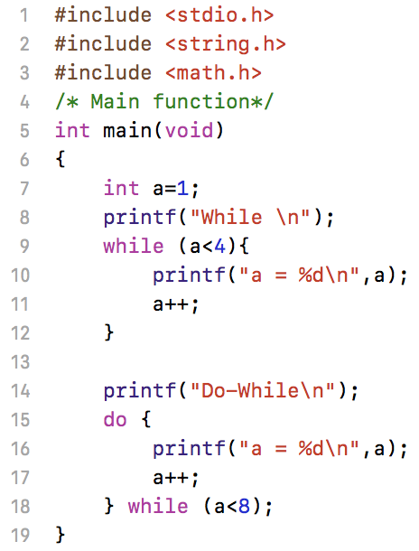
Loopy Loops: While & do-while
while loop:
while (expression){ statements …}
evaluates condition before loop
do-while loop:
do {statements …} while(expression);
evaluates condition after loop

Slide 21
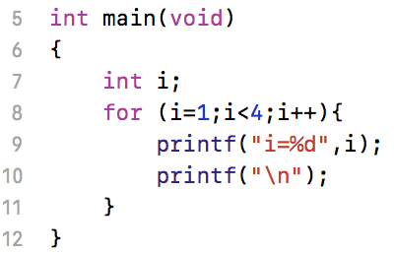
Loopy Loops: For
for (initialize;condition;increment){statements…}
declare loop variable before for
for requires three expression inside ()
i++ is equivalent to i=i+1

Slide 22
Handout
Download and work on handout

